Slide 1

REAL ESTATE
http://realty-real-estatem1.upskills.in/

Slide 2

Modules
Homepage (Team)
Login/Register (Prudhvi)
Dashboard (Sandhya)
Profile Section (Bhavana)
Posts (Vinay)
Media (Ananth)
Comment (Prudhvi)
Properties (Kiran)
Users (Rajat)

Slide 3

Real Estate Project
As many noticed the advancement of the real estate industry, the real estate industry agents, property owners, and the sellers have identified that the internet is the best tool to enhance their business.
This is the reason why many agents are showing the utmost interest in real estate application development.

Slide 4
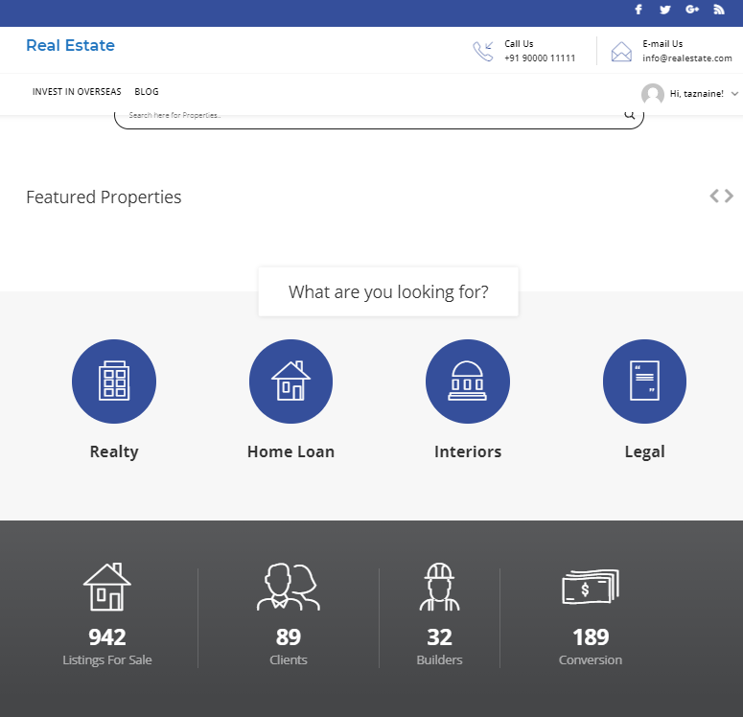
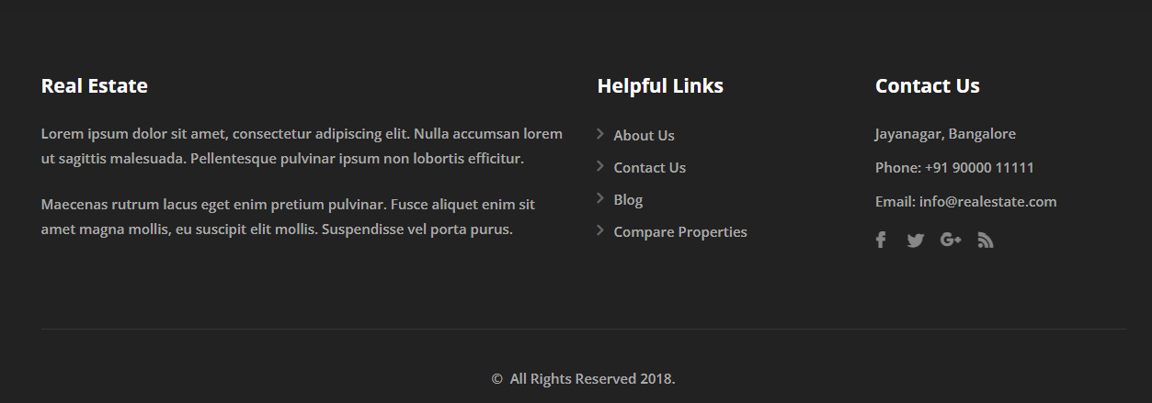
HOMEPAGE
Instant checking about the availability of the property
Real-estate agents can have easy access to their customers
Instant property evaluation and market value
Easy sell, rent or lease your property
Search anywhere and anytime
Promotes stronger Marketing and Communication between Users at a single point

Slide 5
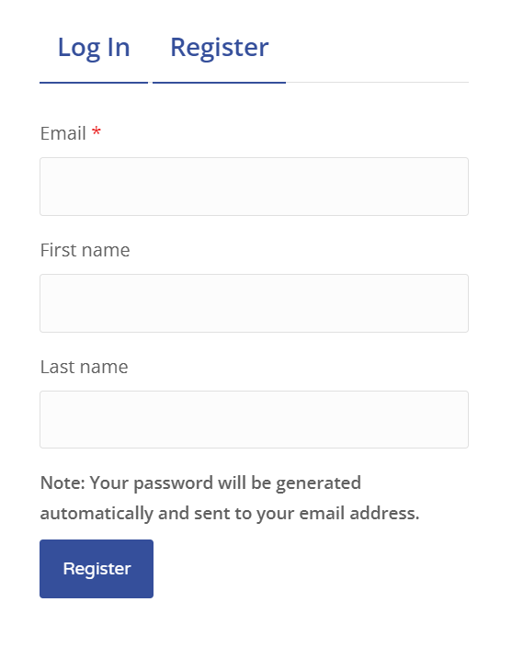

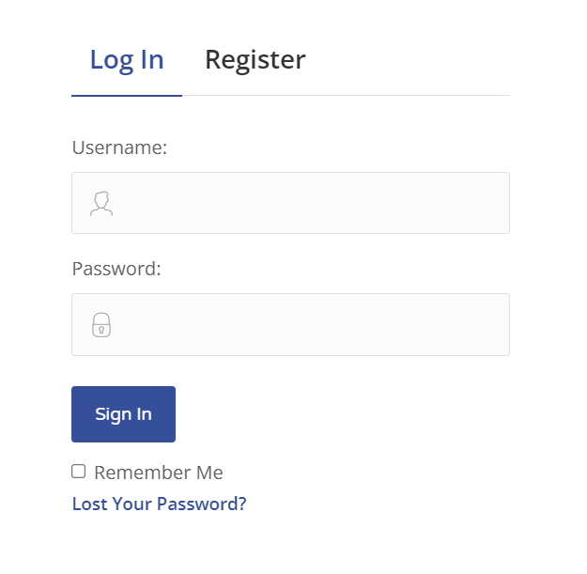

Login/Register module
Login
Login
Register

Slide 6
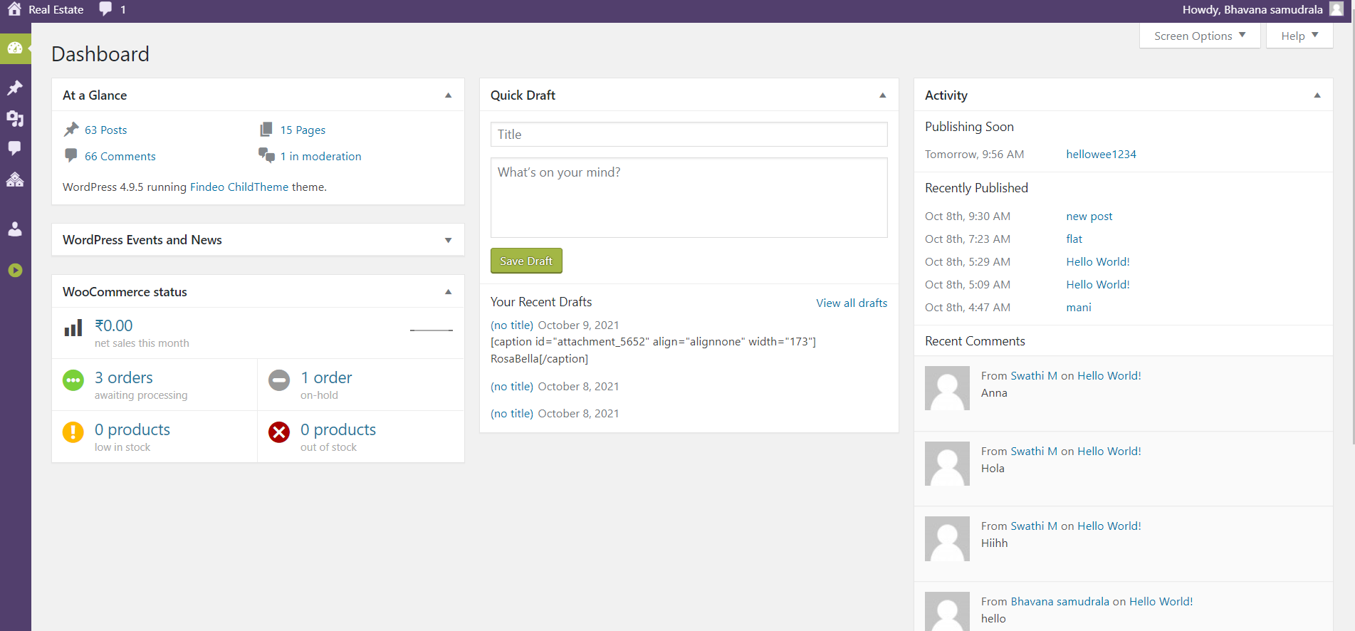
DASHBOARD:
Dashboard is a main page of the application.
Dashboard helps to navigate to every other module present in the Application.
Admin can check the activity of the website

Slide 7
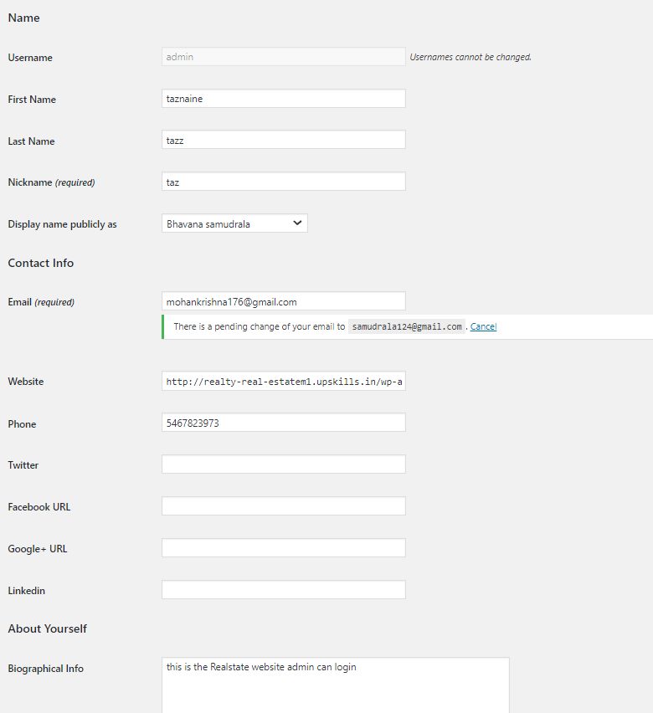
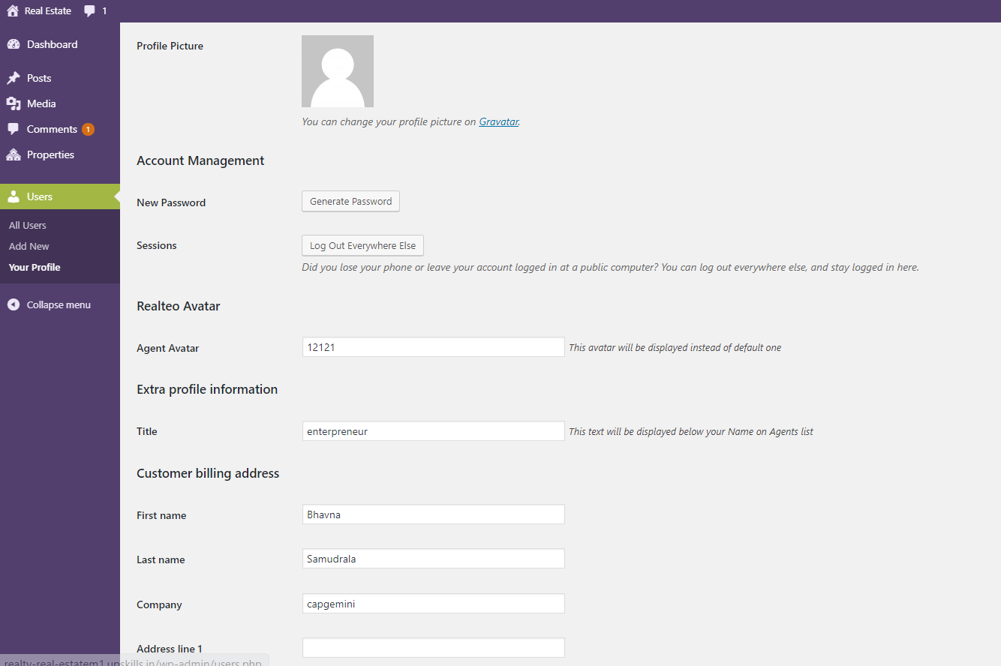
Profile SECTION
Admin can update his/her details in profile section

Slide 8
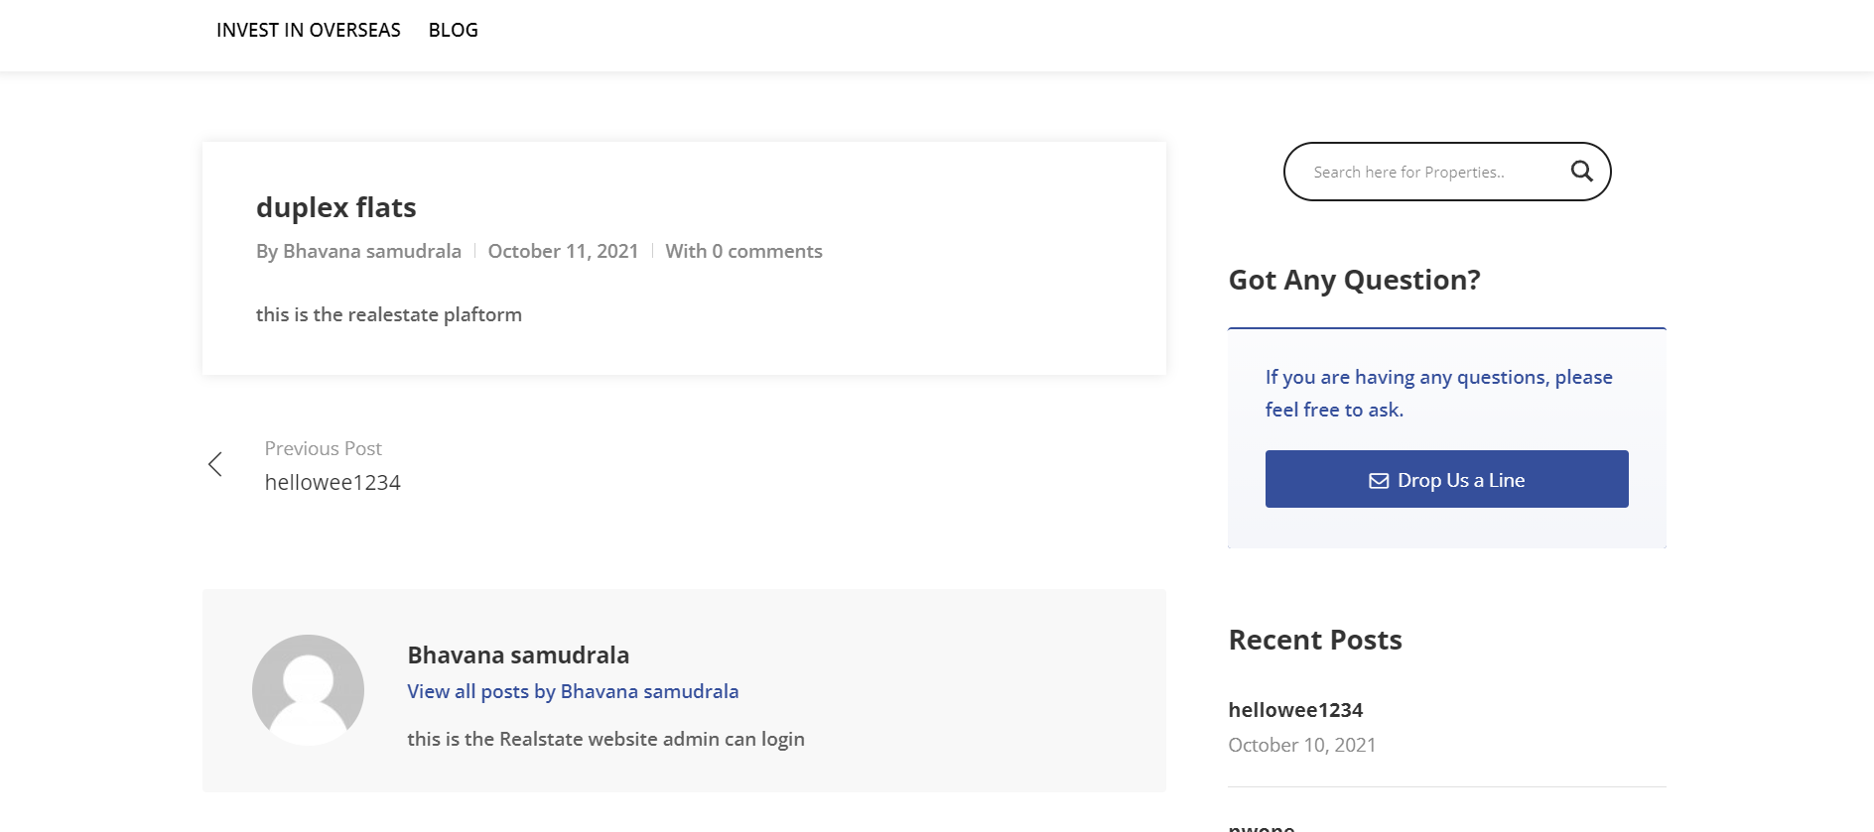
POSTS

Slide 9
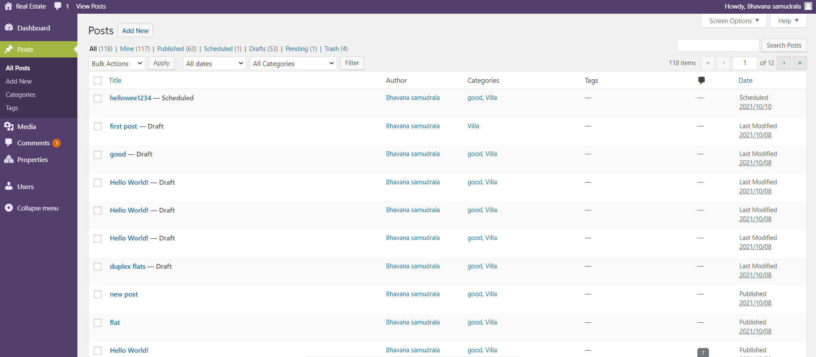
POSTS

Slide 10
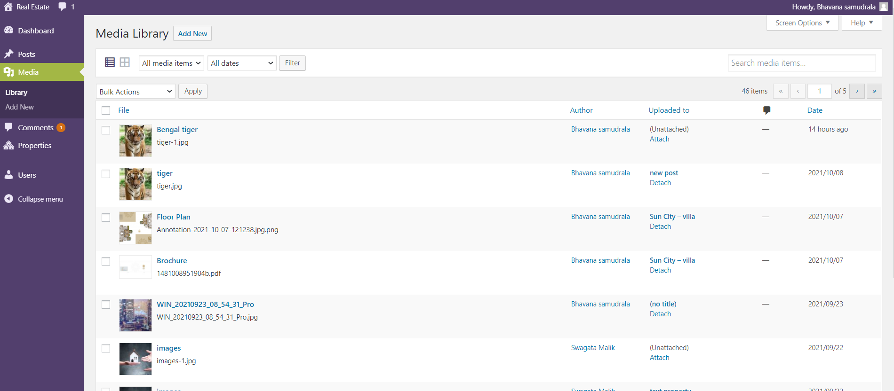
Media

Slide 11
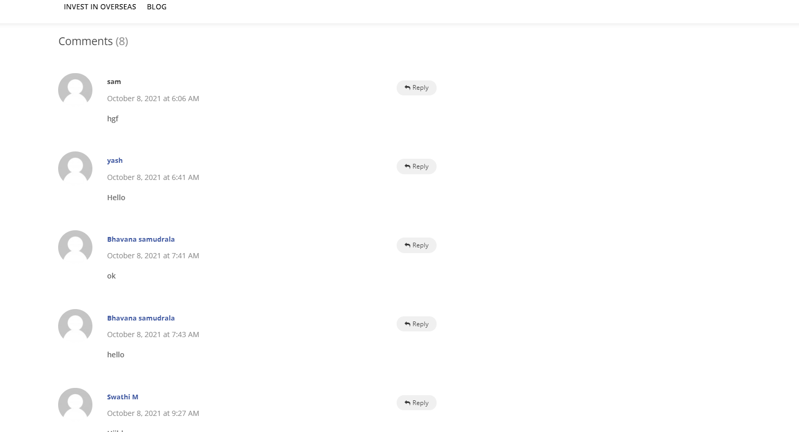
Comments

Slide 12
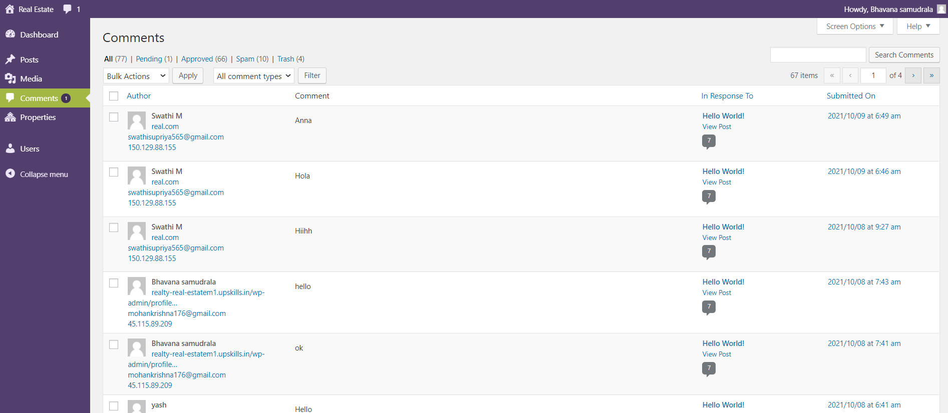
Comments

Slide 13
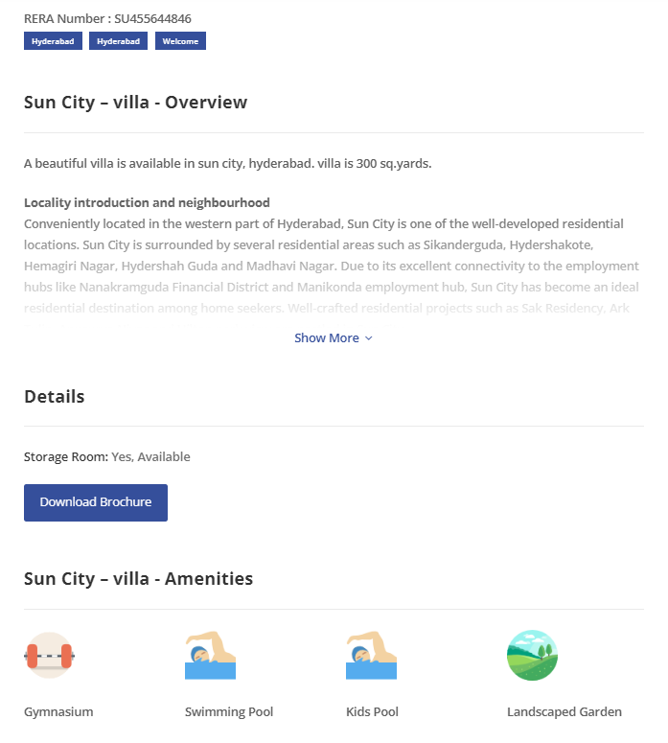
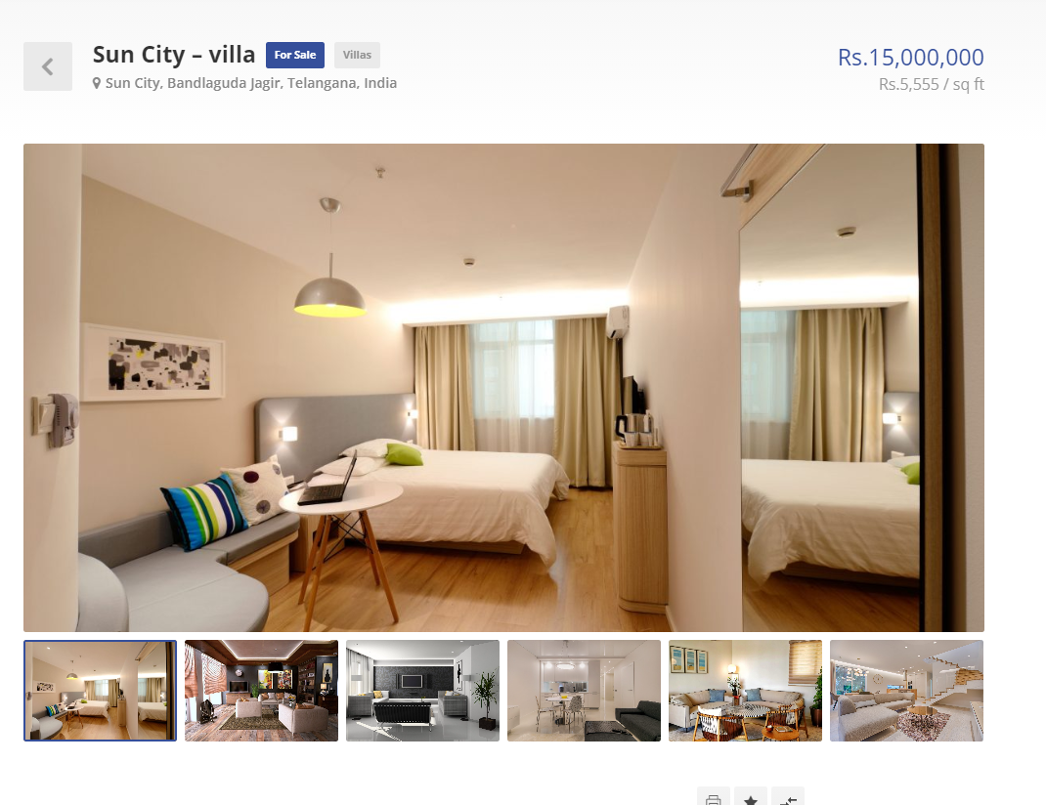
PROPERTIES

Slide 14
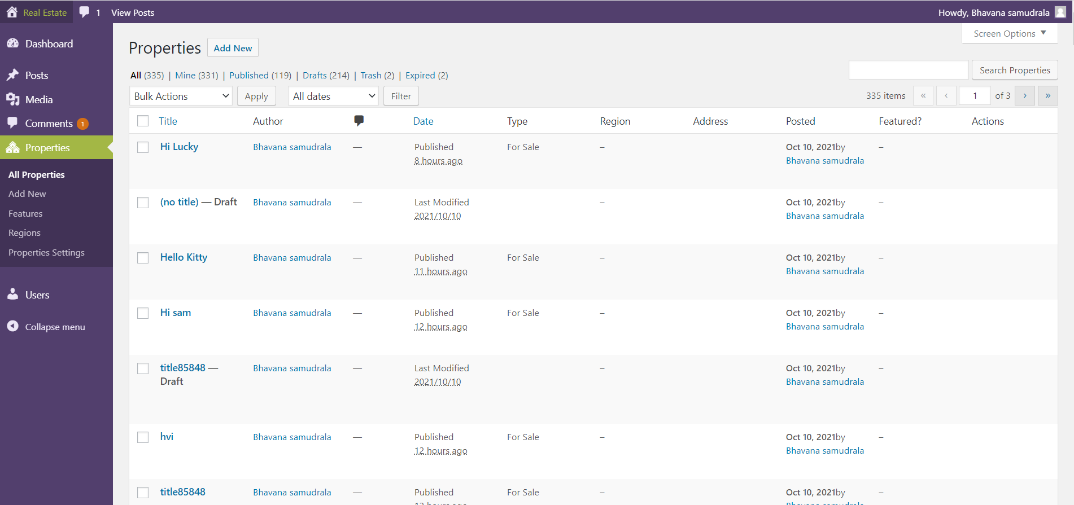
Properties

Slide 15
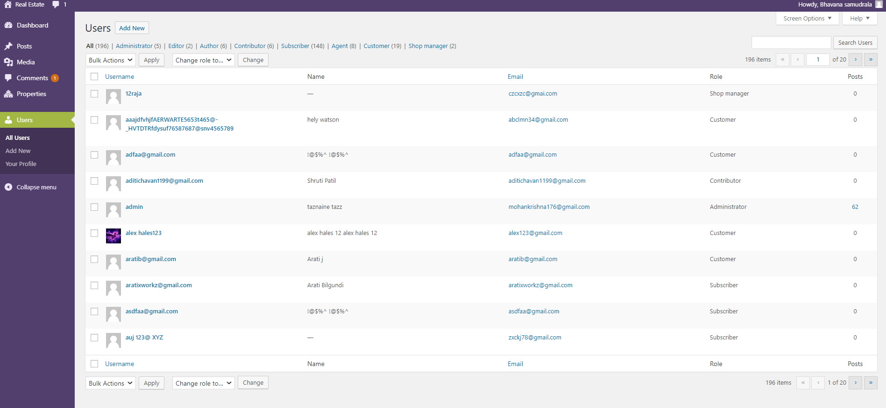
USERs

Slide 16
Thank you
info@realestate.com
http://realty-real-estatem1.upskills.in/

